Slide 1
Engagement Aware Movie Recommendation
Project Pre-Final Check-in
Arnav Kamra, Illy Hoang, Rhea Pandita, and Sanjay Balasubramaniam

Slide 2
Project Overview
Learning Content and Behavioral Embeddings for Engagement-Aware Sequential Movie Recommendation
Streaming platforms rely heavily on recommendation systems to drive engagement
Goal: improve quality + relevance + engagement of recommendations
Core Question: Can we leverage content similarity, user engagement patterns, and contextual embeddings to improve sequential movie recommendations and maximize sustained interaction?
Datasets:
Netflix UK Movies Clickstream Dataset (Kaggle)
Includes User interactions (click/view sequences), Timestamps, Movie IDs
Implicit feedback from using clicks instead of ratings
Sparse interactions emulate realistic recommender setting
Captures real user behavior over time
User reviews + Movie metadata also used to enrich
Objectives:
Build a session-based recommender that
Predicts next item in a user session
Generates Top-10 recommendations
Notes:
While other approaches to recommendation such as collaborative filtering and content-based filtering primarily focus on predicting the next likely item a user might click on, they do not explicitly account for the quality of engagement with that content.
For example, a user may have watched a slow-paced movie most recently, but that does not necessarily imply that the user prefers slow-paced content. The system may recommend similar slow-paced movies purely based on recency or similarity, even if the user did not fully engage with that content.
Similarly, collaborative filtering methods may recommend items based on patterns observed in similar users, but they do not distinguish between content that users merely interacted with and content that led to deeper engagement, such as full completion or repeated viewing.
Recent approaches using sequential models such as RNNs and Transformers attempt to model user behavior over time by capturing session-level or sequential patterns. However, these models are still primarily optimized for next-item prediction and do not explicitly incorporate engagement signals such as watch duration, or interaction intensity.
While prior approaches such as collaborative filtering and content-based filtering focus on predicting the next likely item a user might click on, they do not explicitly account for the quality of engagement with that content.
For example, a user may have watched a slow-paced movie most recently, but that does not necessarily imply that the user prefers slow-paced content. The system may recommend similar slow-paced movies purely based on recency or similarity, even if the user did not fully engage with that content.
Similarly, collaborative filtering methods may recommend items based on patterns observed in similar users, but they do not distinguish between content that users merely interacted with and content that led to deeper engagement, such as full completion or repeated viewing.
Recent approaches using sequential models such as RNNs and Transformers attempt to model user behavior over time by capturing session-level or sequential patterns. However, these models are still primarily optimized for next-item prediction and do not explicitly incorporate engagement signals such as completion rate, watch duration, or interaction intensity.
In this project, we aim to predict the next click by incorporating engagement-aware signals into the recommendation process.
Specifically, we combine:
Content similarity (genres, metadata, semantic features)
User behavior patterns (watch history, frequency, recency)
Engagement signals (watch duration, repeated interaction)
to build a recommendation system that prioritizes content likely to result in sustained engagement rather than just immediate interaction.

Slide 3
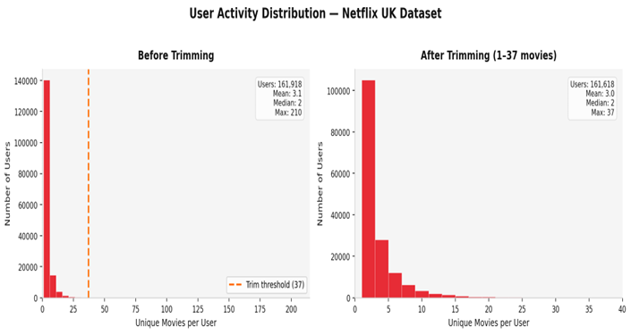
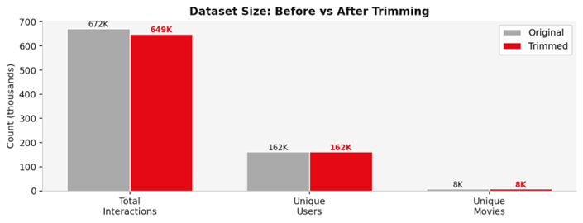
Dataset
The dataset is Netflix Audience Behaviour — UK Movies — anonymised click-stream data from opted-in UK Netflix subscribers spanning Jan 2017 to Jun 2019.
Each record captures a single watch event (user ID, movie ID, timestamp), giving 671,736 interactions across 161,918 users and 8,472 movies.
We filter the dataset to retain users with 1 to 37 unique movie interactions removing 299 super-users (top 0.18%) who watched up to 210 movies, more than 8σ above the mean (μ=3.1, σ=4.3). Such outliers risk dominating learned embeddings and skewing recommendations away from typical viewers [Koren et al., 2009, Herlocker et al., 2004].
The trimmed dataset retains 96.7% of the original data (649,250 interactions, 161,618 users), confirming the core distribution is preserved.
To enrich the base click-stream data, two supplementary feature datasets were constructed by querying the TMDB (The Movie Database) API.
User Features capture behavioural patterns per user
Item Features capture movie-level metadata and popularity signals
Koren, Yehuda & Bell, Robert & Volinsky, Chris. (2009). Matrix factorization techniques for recommender systems. IEEE, Computer Journal, 42(8), 30-37. Computer. 42. 30 - 37. 10.1109/MC.2009.263.
Jonathan L. Herlocker, Joseph A. Konstan, Loren G. Terveen, and John T. Riedl. 2004. Evaluating collaborative filtering recommender systems. ACM Trans. Inf. Syst. 22, 1 (January 2004), 5–53. https://doi.org/10.1145/963770.963772
Notes:
Speaker Notes — Dataset Slide
This slide covers our dataset and the key preprocessing decisions we made before training any model.
We're using the Netflix Audience Behaviour UK Movies dataset — a real-world click-stream collected from opted-in UK subscribers between 2017 and 2019. Importantly, this is implicit feedback — there are no star ratings, just watch events, which makes it a realistic and challenging setting for a recommendation system.
User Features (46 columns) capture behavioural patterns per user — including total clicks, unique items watched, repeat ratio, session-level stats (count, avg length, gap between sessions), viewing time preferences (mean hour, weekend ratio), tenure, engagement tier, preferred release decade, and genre affinity scores across 20+ genres derived from their watch history.
Item Features (47 columns) capture movie-level metadata and popularity signals — including title, release year, decade bucket, runtime, TMDB popularity score, vote average, original language, log-transformed click popularity, repeat watch ratio, item age, and one-hot encoded genre tags across the same genre taxonomy.
On why we didn't remove users with very few interactions — We deliberately kept users with as little as 1 movie watch. The reason is that removing them would mean we're only evaluating our models on already-engaged, easy-to-recommend-for users, which inflates your metrics artificially. In a real Netflix deployment, a huge portion of your user base are low-activity users — ignoring them means your model has never seen that pattern and completely fails them at inference time. That's the cold-start problem, and rather than sidestepping it by cleaning it away, we kept those users in to force our models to handle it. Our results — particularly BERT4Rec achieving HR@10 of 0.3085 and NDCG@10 of 0.2081 — were obtained on this full, difficult distribution, not a cherry-picked subset of power users. So the numbers are honest.
On why we removed the top end — The 299 super-users who watched 38 to 210 unique movies are a completely different behavioural profile — likely bots, power testers, or internal accounts. Their interaction sequences are so long and atypical that during training they contribute disproportionately to the loss, pulling the model to optimise for behaviour that represents 0.18% of users. In embedding-based models like BERT4Rec, these users can anchor the latent space in ways that hurt everyone else's recommendations. Removing them is not cherry-picking — it's noise removal.
On what would happen if we kept them — If we had kept the super-users, we would likely see slightly better aggregate metrics because the model overfits to those rich interaction histories, but real-world performance on typical users — the ones with 1 to 5 watches — would degrade. Essentially you'd be optimising for the wrong population.
On cold-start — We acknowledge cold-start is a genuine limitation here. With 133,000 users having fewer than 5 interactions, collaborative signals are very weak. Our partial mitigation is the TMDB-enriched item and user feature tables — by incorporating genre affinities, popularity, runtime, and release decade, models have content-based signals to fall back on even when interaction history is sparse.

Slide 4
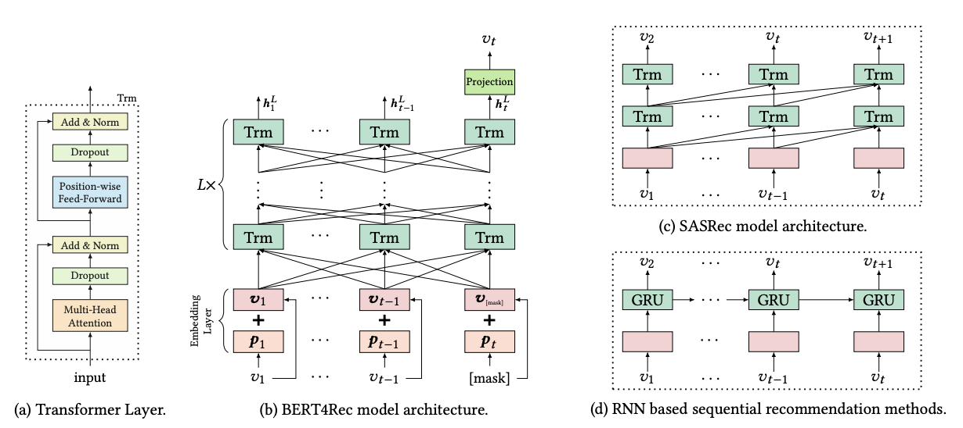
Experiments
Baseline architectures
Sequential Models – GRU4Rec, SASRec, BERT4Rec
Graph-Based Model – LightGCN
Hybrid Models (candidate generation → reranking ) – GRU+LightGCN, SASRec+LightGCN
Sun, Fei, et al. "BERT4Rec: Sequential recommendation with bidirectional encoder representations from transformer." Proceedings of the 28th ACM international conference on information and knowledge management. 2019.
Extended baseline with multi-objective loss
Loss = Cross Entropy + λ_{diversity}​ + λ_{novelty}​(+λ_{kl}​)
Intention: Move beyond accuracy to improve recommendation quality
Training
Data: Session-based sequences (timestamp ordered)
Split: Train (sequence[:-2]) / Val (penultimate item) / Test (final item)
Mini-batch w/ Adam optimizer, Early stopping, Hyperparam grid search
Evaluation Metrics: HR@10, NDCG@10, MRR, Avg Cosine Similarity (semantic relevance)
Notes:
In this section, we evaluate a range of baseline architectures covering sequential, graph-based, and hybrid models. For sequential modelling, we use GRU4Rec, SASRec, and BERT4Rec, which capture user behaviour from ordered interaction sequences. For graph-based modelling, we use LightGCN, which learns collaborative filtering signals from the user–item interaction graph. We also explore hybrid approaches such as GRU-LightGCN and SASRec-LightGCN, where we combine candidate generation with reranking to integrate both sequential and graph signals.
To move beyond pure accuracy, we extend our baseline models using a multi-objective loss function. In addition to the standard cross-entropy loss for next-item prediction, we incorporate diversity and novelty terms, and optionally a KL regularisation term. The goal here is to improve overall recommendation quality by encouraging the model to produce more varied and less popularity-biased recommendations.
For training, we use session-based sequences ordered by timestamp. We adopt a leave-one-out style split, where the last item is used for testing, the second-to-last for validation, and the remaining sequence for training. Models are trained using mini-batches with the Adam optimizer, along with early stopping and hyperparameter tuning. Finally, we evaluate performance using ranking-based metrics such as HR@10, NDCG@10, MRR, and a diversity metric based on cosine similarity between recommended items.
1. HR@K (Hit Rate @ K)
Measures whether the correct item appears in the top-K recommendations.
2. NDCG@K (Normalized Discounted Cumulative Gain)
Measures ranking quality, giving higher weight if the correct item appears near the top.
3. MRR (Mean Reciprocal Rank)
Measures how early the correct item appears in the ranked list.

Slide 5
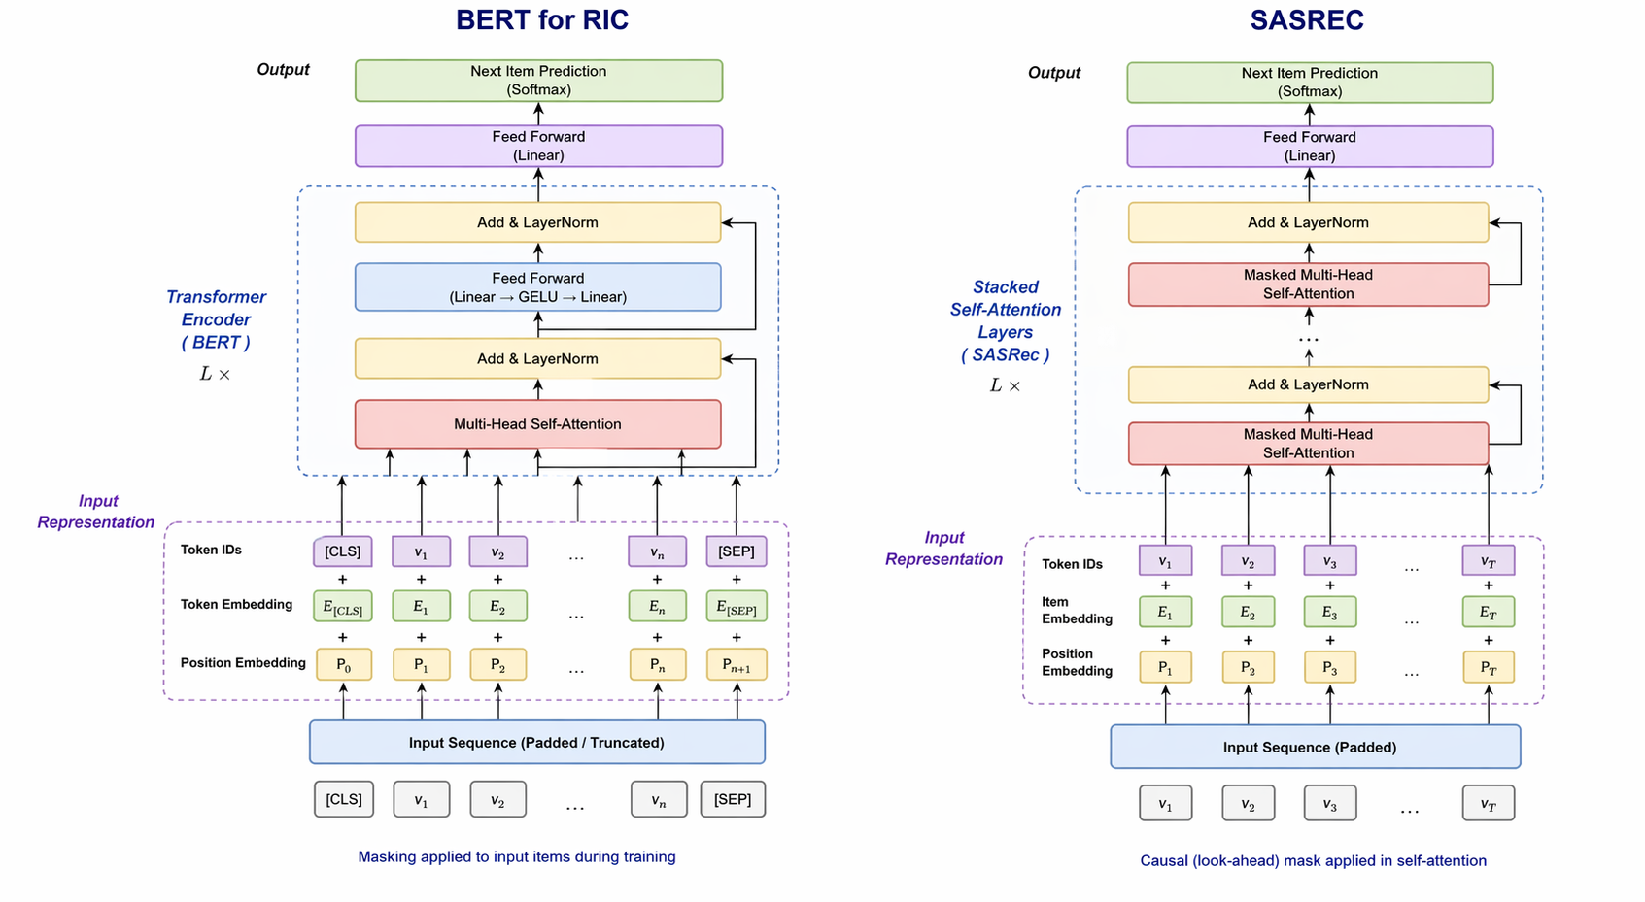
Sequential Models (Transformer-based Recommendation)
We implement BERT4Rec (Sun et al., 2019) and SASRec (Kang & McAuley, 2018), both based on transformer architectures.
BERT4Rec uses bidirectional attention with masked prediction, while SASRec uses causal masking, restricting attention to past interactions only. Both models learn user representations from sequences and predict the next item using a full softmax over all items.
Fig 4.1 Architecture diagram for Bert4Rec (left) and SASRec (right)
We extend both models by injecting item features (genres, popularity) and user features (engagement, preferences) through gated projections before the transformer layers.
We also replace the original output layer with a deeper classifier MLP, use Pre-LayerNorm for stability, and apply a popularity-debiased loss to reduce bias toward frequently watched items. By incorporating side information and stabilising training, we improve generalisation and allow the models to better handle short user histories.
Notes:
BERT4Rec randomly masks a subset of items in the sequence during training and learns to predict those masked items using the full surrounding context. This means the model uses bidirectional self-attention, so each item representation is informed by both past and future interactions. As a result, it learns a richer representation of user preferences compared to strictly sequential models.
In our implementation, we extend the original BERT4Rec by incorporating item features like genres and popularity, and user features such as engagement and preferences, which are injected through gated projections before the transformer layers. We also replace the simple output layer with a deeper classifier MLP and use a popularity-debiased loss, which helps prevent the model from over-recommending popular items. At inference time, we append a MASK token at the end of the sequence and ask the model to predict the most likely next item.
🎤 SASRec — Speaker Notes
SASRec uses causal self-attention on past inputs in a seq to predict the next-item, like real-world recommendation scenarios, where predictions are based only on historical behaviour. SASRec iincorporates item and user features through gated fusion mechanisms, allowing the model to combine behavioural signals with side information. We also apply a popularity-debiased loss and use Pre-LayerNorm for more stable training.
One limitation of SASRec is that it depends heavily on the amount of past interaction data. Since it cannot use future context, it may struggle with very short sequences, which is relevant in our dataset where many users have limited history. However, SASRec is efficient and effective at capturing recency effects and temporal dynamics, making it a strong baseline for sequential recommendation tasks.
Bert Rec
Why it scores like this: Bidirectional attention + masked training lets it use the entire sequence and your feature fusion, so it extracts strong signal even from 1–5 interactions.
What’s limiting: Tends to bias toward popular/co-occurring items and isn’t causal, so it can’t be cleanly used for RL-style optimisation.
SASRec (your case)
Why it scores like this: Captures recency and order with causal attention; works well when even short histories have meaningful order.
What’s limiting: With very short sequences it has less context than BERT4Rec (no right-side info), so it can’t compensate for sparsity as well.

Slide 6
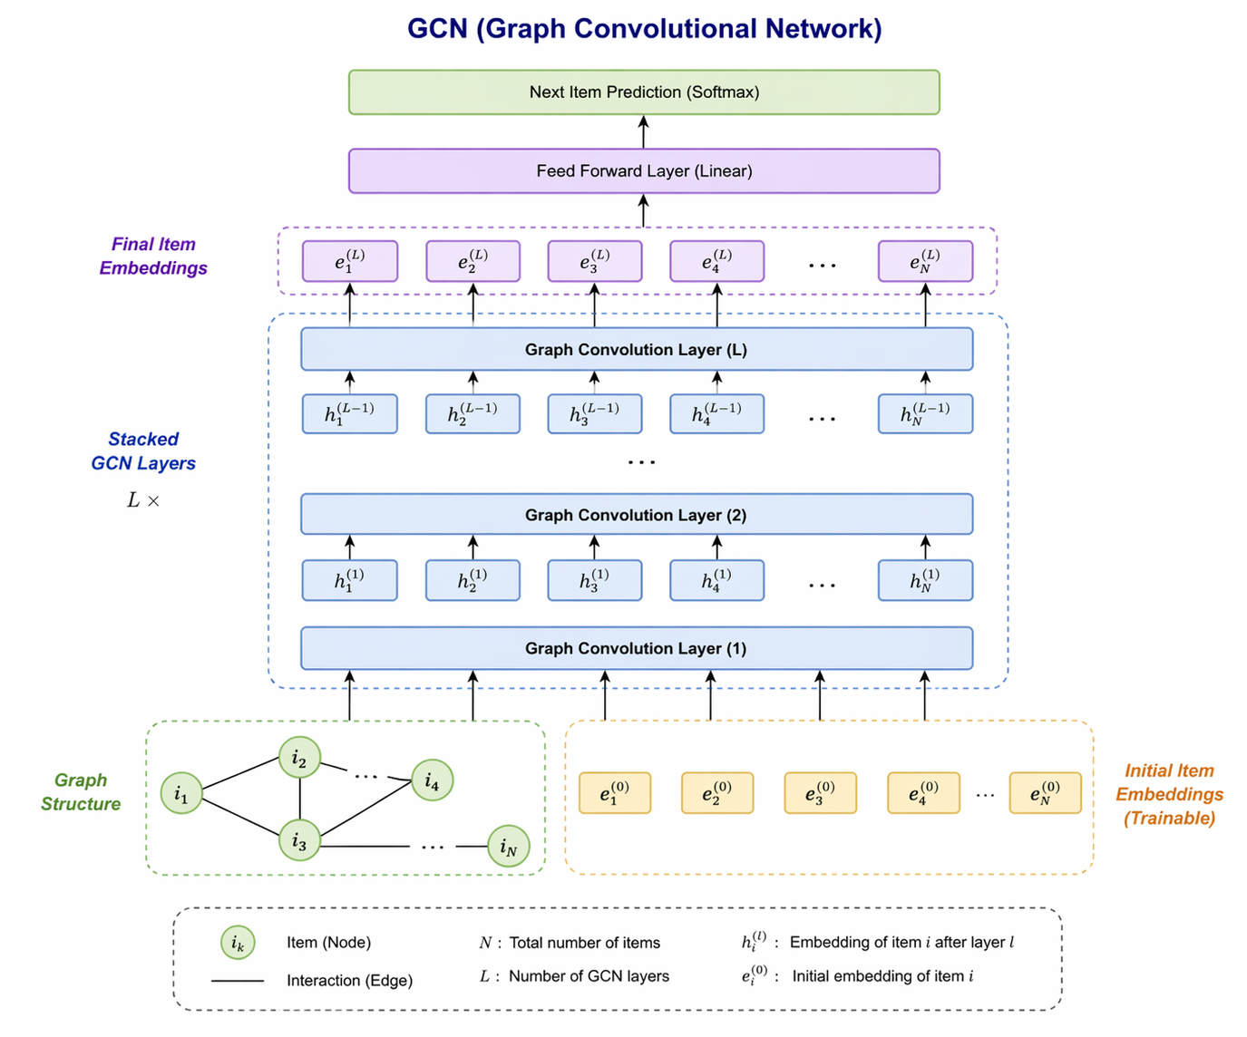
Graph-Based Models (Collaborative Filtering)
We use LightGCN (He et al., 2020), which learns embeddings by repeatedly propagating information over the graph using a normalised adjacency matrix.
At each layer, a node updates its representation by aggregating embeddings from its neighbours, allowing user and item embeddings to incorporate higher-order connectivity.
The final embedding is computed as the average over multiple propagation layers, ensuring stable and smooth representations.
These embeddings are precomputed once per epoch and injected into downstream models via a learnable gating mechanism, alongside base embeddings and feature projections.
This avoids backpropagating through sparse graph operations, improving computational efficiency and stability .
Fig 4.2 Architecture diagram for Light GCN
Notes:
LightGCN models the recommendation problem as a user–item interaction graph, where users and movies are nodes and an edge represents that a user has watched a movie. Unlike sequential models, it ignores the order of interactions and focuses purely on collaborative filtering, meaning it learns that users who watch similar movies tend to have similar preferences. This allows the model to capture global patterns such as “users who watched this movie also watched these other movies.”
The core mechanism of LightGCN is graph propagation. Each user and item starts with an initial embedding, and at each layer, these embeddings are updated by averaging information from their neighbours. For example, a movie embedding is influenced by all users who watched it, and those users are influenced by other movies they watched. After multiple layers, the model captures higher-order relationships, meaning a movie can become similar to other movies indirectly through shared users. The final embedding is taken as an average across all layers, which helps produce stable representations.
However, in our dataset, most users have very few interactions—typically between 1 and 5 movies—which results in a sparse graph with weak connectivity. This limits LightGCN’s ability to learn strong collaborative signals, since there are fewer overlapping interactions between users. To address this, we use LightGCN not as a standalone model, but as an embedding enhancer.
LightGCN (your case)
Why it scores like this: Learns from user–item co-consumption, but your graph is sparse (few interactions per user), so embeddings are weak and drift toward popular items.
What’s limiting: Low user overlap → weak multi-hop signal; features are added later and can’t fully replace missing behavioural links.

Slide 7
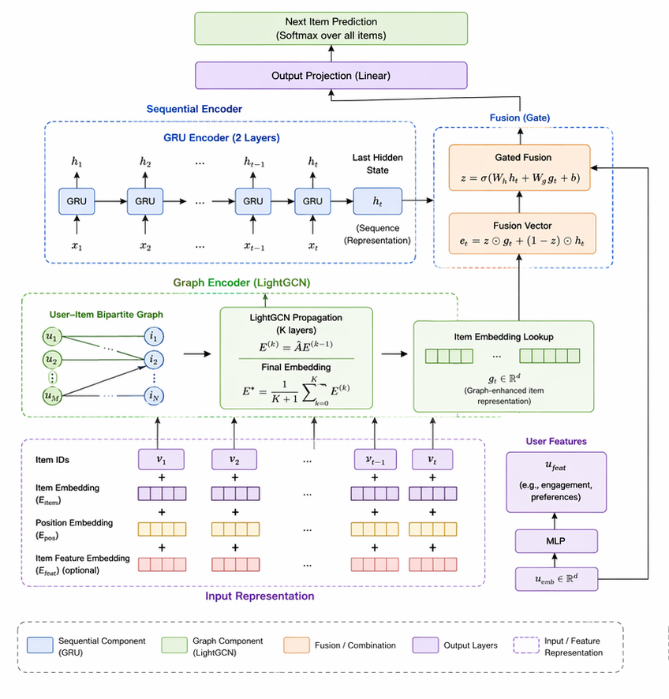
Hybrid Models (Sequential + Graph Integration)
In our dataset, user sequences are relatively short, which makes purely sequential models data-limited, while graph models lack ordering information.
We implement a GRU-LightGCN architecture, where LightGCN first learns graph-enriched item embeddings by propagating information across the user–item interaction graph.
These embeddings capture long-range relationships effectively encoding collaborative filtering signals.
These graph-enhanced embeddings are then fed into a two-layer GRU, which processes the interaction sequence in order.
At each timestep, the GRU updates a hidden state that summarises the user’s evolving preferences, capturing recency and sequential patterns.
Fig 4.2 Architecture diagram for Hybrid GRU + Light GCN
The final hidden state serves as a compact representation of the user’s current intent and is used to predict the next item via a shared embedding projection.
Notes:
The hybrid model is designed to integrate multiple sources of information to better represent user preferences. In our setup, we combine graph-based embeddings from LightGCN, which capture relationships between users and items, with sequential modelling using a GRU, which captures how user preferences evolve over time. This allows the model to incorporate both long-range behavioural patterns and short-term user intent.
The process begins with LightGCN, which operates on the user–item interaction graph to generate graph-enriched item embeddings. These embeddings reflect patterns such as users who tend to watch similar sets of movies. We then combine these graph embeddings with base item embeddings, item features like genre and popularity, and user-level features such as engagement and preferences. This fusion is done using learnable gating mechanisms, which allow the model to dynamically control how much it relies on each source of information.
The resulting sequence of enriched item representations is then passed through a two-layer GRU, which processes the interactions in order and updates a hidden state at each timestep. This hidden state acts as a summary of the user’s evolving preferences. The final hidden state represents the user’s current intent and is used to predict the next item. By combining collaborative signals, content features, and temporal dynamics in a unified framework, the hybrid model provides a more comprehensive representation of user behaviour.
GRU–LightGCN (Hybrid, your case)
Why it scores like this: Combines GRU (sequence/recency) with LightGCN (collaborative) plus features, so it improves over graph-only by using temporal signal.
What’s limiting: Graph contribution is small (gating downweights it due to sparsity) and early stopping prevents full convergence, so gains remain modest.

Slide 8
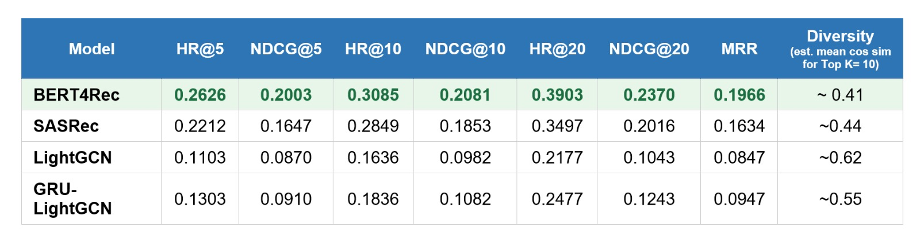
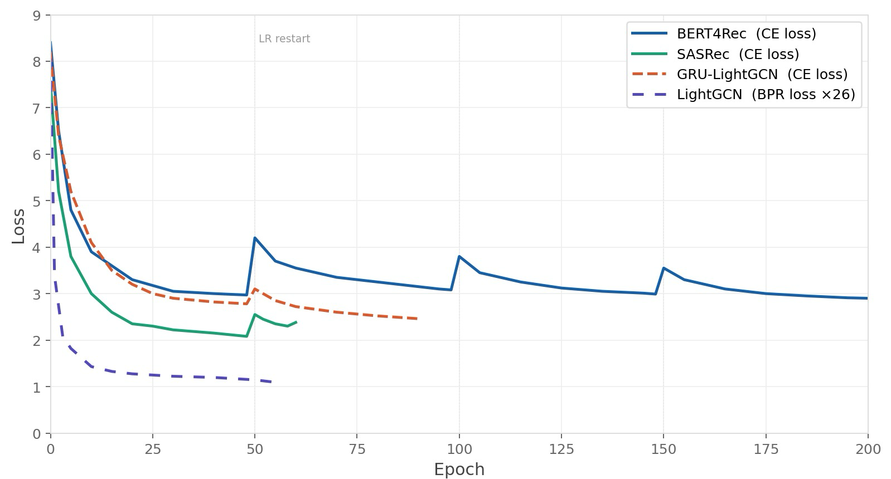
Results
BERT4Rec v2 performs best: strong gains from bidirectional content
Constraint: Only 38% true-item coverage on any post-processing
Main takeaway: Improving the base model + lightweight reranking is the most reliable path to near state-of-the-art performance.
HR@K (Hit Rate): Did we recommend the correct item in the top K? (binary success metric) NDCG@K: Measures ranking quality — rewards placing the correct item higher in the list. MRR (Mean Reciprocal Rank): Focuses on how early the correct item appears — higher if it’s ranked near the top.
Notes:
Quick model overview:
BERT4Rec uses a bidirectional transformer, meaning it looks at the full sequence context (past + future) to predict the next item — this gives it a strong advantage, especially with short user histories.
SASRec is also transformer-based but causal (left-to-right), so it only uses past behavior — slightly more realistic but less informative here.
GRU-LightGCN combines sequential modeling (GRU for order/recency) with graph-based collaborative filtering (LightGCN for user-item relationships).
Metrics explained:
HR@K (Hit Rate): Did we recommend the correct item in the top K? (binary success metric)
NDCG@K: Measures ranking quality — rewards placing the correct item higher in the list.
MRR (Mean Reciprocal Rank): Focuses on how early the correct item appears — higher if it’s ranked near the top.
Key intuition:
HR tells you if you got it right,
NDCG and MRR tell you how well ranked your correct prediction was.
Reranker reorders top candidate items using additional features without changing the base model — very stable and effective.
Aux Fine-tuning adds extra training objectives (diversity, novelty) to improve recommendations.
DPO learns preferences between correct vs incorrect items, but can overfit.
Actor-Critic RL tries to optimize a reward function, but fails here since recommendation is a single-step problem.
For implicit-feedback recommendation tasks (like next-item prediction):
HR@K
HR@10
Weak: < 0.10
Average: 0.10 – 0.25
Strong: 0.25 – 0.40
Excellent: > 0.40
NDCG@K
NDCG@10
Weak: < 0.08
Average: 0.08 – 0.15
Strong: 0.15 – 0.25
Excellent: > 0.25
MRR
Weak: < 0.05
Average: 0.05 – 0.15
Strong: 0.15 – 0.30
Excellent: > 0.30
These ranges are consistent with benchmarks on datasets like:
MovieLens
Amazon product data
Yelp / retail logs

Slide 9
Challenges
Problem: Creating realistic synthetic data for a movie recommender is difficult for emulating real watch history.
Solution: Use a real-world Netflix user history dataset
Problem: Relying only on movie watch history data
Solution: Enhance initial ranking by incorporating real-world review and clickstream data alongside watch history.
Problem*: Current movie features are too coarse—basic titles and review embeddings. Model performance is not great.
Solution: Enrich each movie with contextualized embeddings built from metadata, plot summaries, actors, and related attributes
Problem*: Varying model architectures have adverse results to the same hypertuning change
Solution: Finalize a model (BERT4Rec or ensemble), and optimize/hypertune for that model specifically
* = Unsolved
Notes:
Representation
First, we represent both users and movies in a way the system can understand
For movies, we can use content-based features like genre, actors, director, or even text descriptions using TF-IDF. This helps us understand what the movie is about.
For users, we build embeddings based on their behavior—like what they’ve watched, liked, or rated.
We also use latent factors from techniques like matrix factorization. These capture hidden patterns—for example, a user might prefer ‘dark thrillers’ even if that’s not explicitly labeled.
So overall, representation is about turning users and movies into vectors in the same space.
Candidate Generation
Next, we narrow down from thousands of movies to a smaller set of candidates.
We can do this using nearest neighbors. For example, if a user liked ‘Inception,’ we find similar movies either based on content or latent embeddings.
We can also use latent-factor retrieval, where we match users to movies using their learned embeddings.
If we consider recent activity, session-aware retrieval helps—like recommending movies similar to what the user just watched.
At this stage, we’re not being perfect—we’re just quickly finding a few hundred good candidates.
Similarity Scoring
Now we score how relevant each candidate movie is for the user.
We use similarity metrics like cosine similarity or dot product between user and movie vectors.
We can also incorporate signals like ratings or watch time to create weighted similarity scores.
For more advanced systems, we might use a neural network, like an MLP, to learn complex relationships between user preferences and movie features.
This step gives us a relevance score for each candidate.
Ranking
Finally, we rank the movies and select the top recommendations.
We typically return the Top-K movies—like the top 10 most relevant ones.
We may also apply re-ranking or post-processing to improve diversity, avoid repetition, or promote newer content.
So the final list isn’t just the most similar—it’s also balanced and personalized.
Experiment: Set up a simple offline benchmark
Use a movie ratings dataset with user history, item metadata, and optional watch-time/session data.
Split data into train/validation/test by time, so older interactions train the model and newer ones test it.
Build a few baseline candidate generators
Content-based retrieval using genre, cast, year, and TF-IDF over descriptions.
Latent-factor retrieval using matrix factorization embeddings.
Session-aware retrieval using recent clicks or watches from the current session.
Compare each one alone, then combine candidates from all three.
Test multiple similarity scoring methods
Score candidates with cosine similarity on embeddings.
Compare against dot product and Euclidean distance.
Add a weighted similarity version that includes rating strength or watch time.
Optional: test a small MLP neural scorer on top of user and item features.
Evaluate ranking quality
Rank Top-K recommendations for each user.
Measure Precision@K, Recall@K, NDCG@K, and Hit Rate@K.
Also track catalog coverage and diversity so results are not too repetitive.
Run ablation experiments
Content-only vs latent-only vs session-only.
Single scorer vs weighted scorer vs neural scorer.
Candidate generation only vs candidate generation plus re-ranking.
This shows which component actually improves performance.
Add simple re-ranking and post-processing tests
Re-rank to boost freshness, diversity, or under-exposed movies.
Filter out already watched items.
Compare recommendation quality before and after post-processing.
Do a lightweight online-style simulation
Replay historical sessions and check whether the next watched movie appears in Top-K.
For ranking, test whether higher-ranked items better match future user choices.
Define success criteria
Improvement over a popularity baseline.
Better Recall@10 or NDCG@10 without hurting diversity too much.
Stable performance across user groups such as new users, active users, and sparse-history users.
If you want, I can turn this into a 1-slide experiment plan or a resume-style project summary.

Slide 10
Next Objectives
Completed
Dataset merging, synthesis, preprocessing
Initial Results
V1 model using movie review data
V2 model using movie metadata embeddings
Next Milestones
April 25: Model fine-tuning and evaluation and improvements
Increase features (movie metadata), Improve results
BERT4Rec finetuning
Reranker, Aux Fine-tuning, DPO, RL techniques
April 27: Further investigation & improvements
Model ensemble
Final Deliverables
Improved models (metadata + engagement-aware)
Movie scoring + platform recommendation system
Notes:
Reranker reorders top candidate items using additional features without changing the base model — very stable and effective.
Aux Fine-tuning adds extra training objectives (diversity, novelty) to improve recommendations.
DPO learns preferences between correct vs incorrect items, but can overfit.
Actor-Critic RL tries to optimize a reward function, but fails here since recommendation is a single-step problem.

Slide 11
Thank You!

